Slide 1

Group 1- Fashion Designing
Presented By:
Shirisha Reddy Rapole
Hema Chaudary Paladugu
Sai Kumar Uppala
Rohith Kumar Agiru

Slide 2


Stephanie M. Jorandby
“Sincere thanks to our client Stephanie M. Jorandby, for giving us this opportunity”

Slide 3

Nathan Eloe
“Sincere thanks to our client Nathan Eloe, for guiding us all the way”

Slide 4
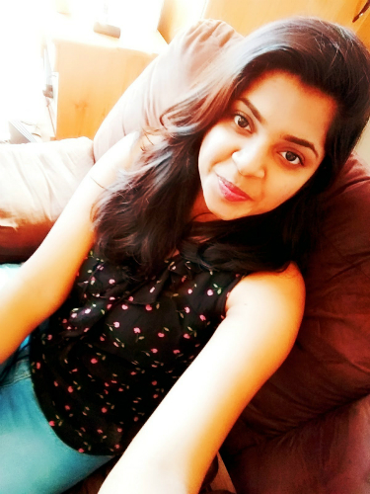
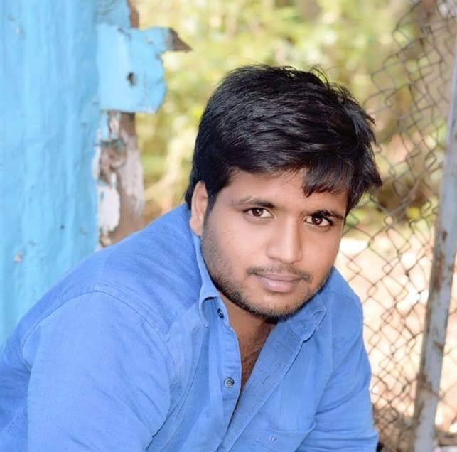
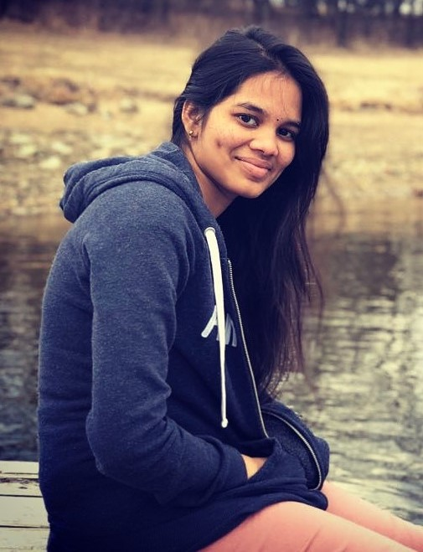

Team Members
Shirisha Reddy Rapole
Rohith Kumar Agiru
Hema Chaudary Paladugu
Sai Kumar Uppala

Slide 5
Contents
Introduction
Problem Statement
Use Cases
Functional Requirements
Architecture diagram/plan
Design patterns
Platforms and technologies
Third party libraries to provide functionality
Hosting strategy and requirements
Security plans
Prototype demos
GUI mockups
Functional prototypes

Slide 6
Introduction
Costume designers make the look of each character by designing clothes and accessories the actors will wear in performance.
It takes a great effort to manage all the information about the performers based on the play.
So the designer need an interface that makes the work easy in selecting the sizes of each individual and communicate it with all the organizers.

Slide 7
Problem Statement
Measurements and information taken in Google forms and spreadsheets consumes more time and effort to produce a costume.
The main problem with the current system is to coordinate the same information with all the workers and designers throughout the designing process.

Slide 8
Problem Statement
Once the designer completes the costume, the organizers shop for the material but they do not have the associated sizes with the material.
The current system does not allow filter and show the measurements that are only required for the particular outfit while designing.

Slide 9
Project Stakeholders
End Users
Designer
Student Organizers
Performer
Lab student
Project Team
Developers
Testers

Slide 10
Use cases
Use cases are used to describe the sequence of interactions between the system and users in a particular environment.
Actors:
Designer
Student organizers
Performer

Slide 11
Use cases
Actions:
Sending forms to performer
Access to organizers
Take measurements
Designer’s pull list
Assigning materials
Shop materials
Design the costumes
Fill measurement form

Slide 12
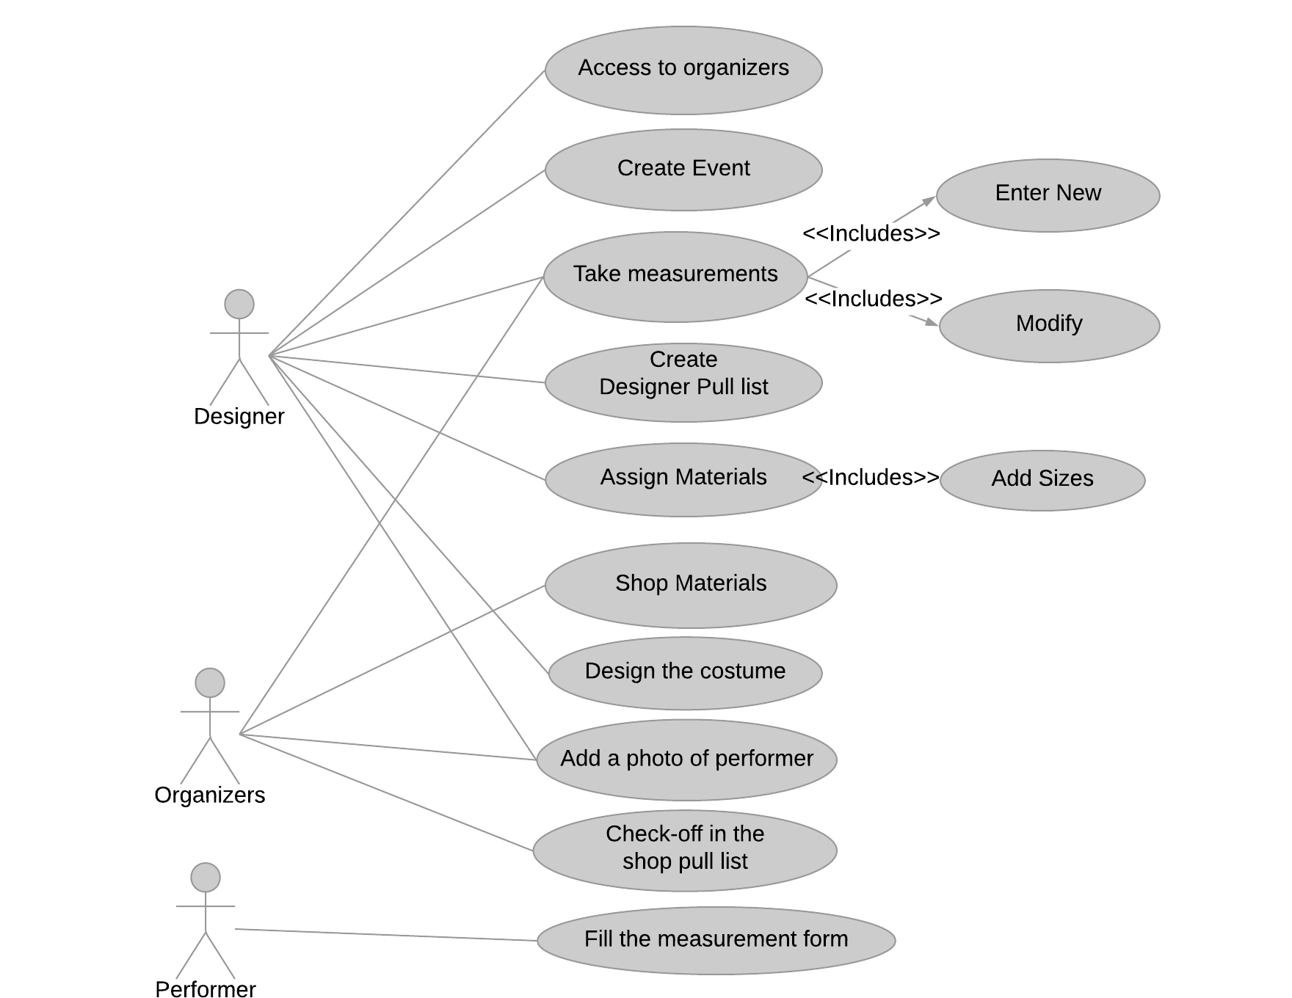
Use case Diagram

Slide 13
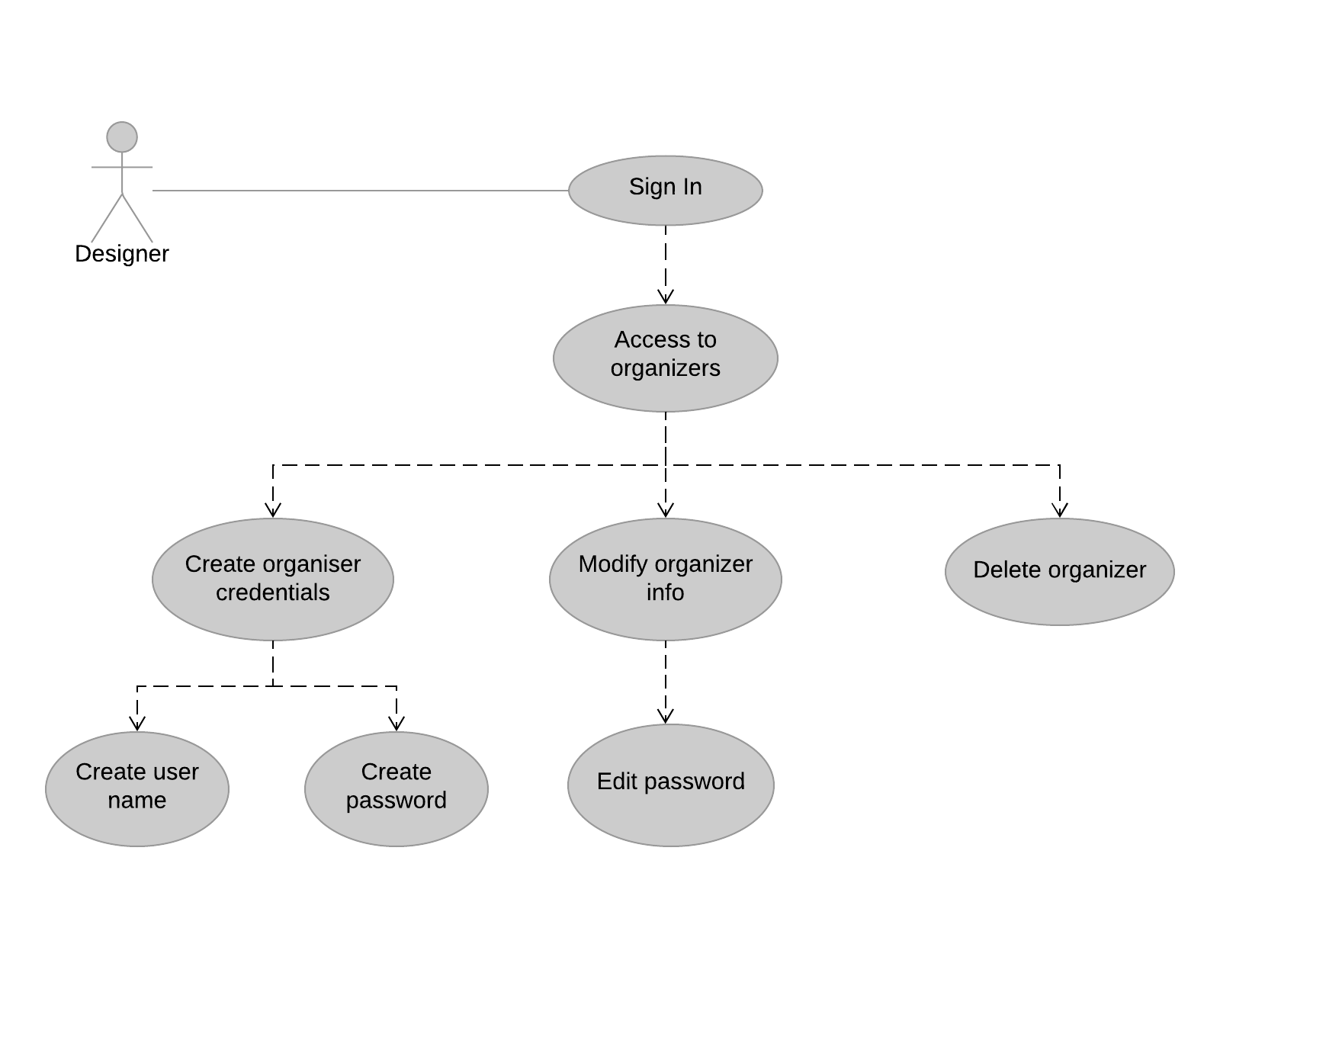
Access to organizers

Slide 14
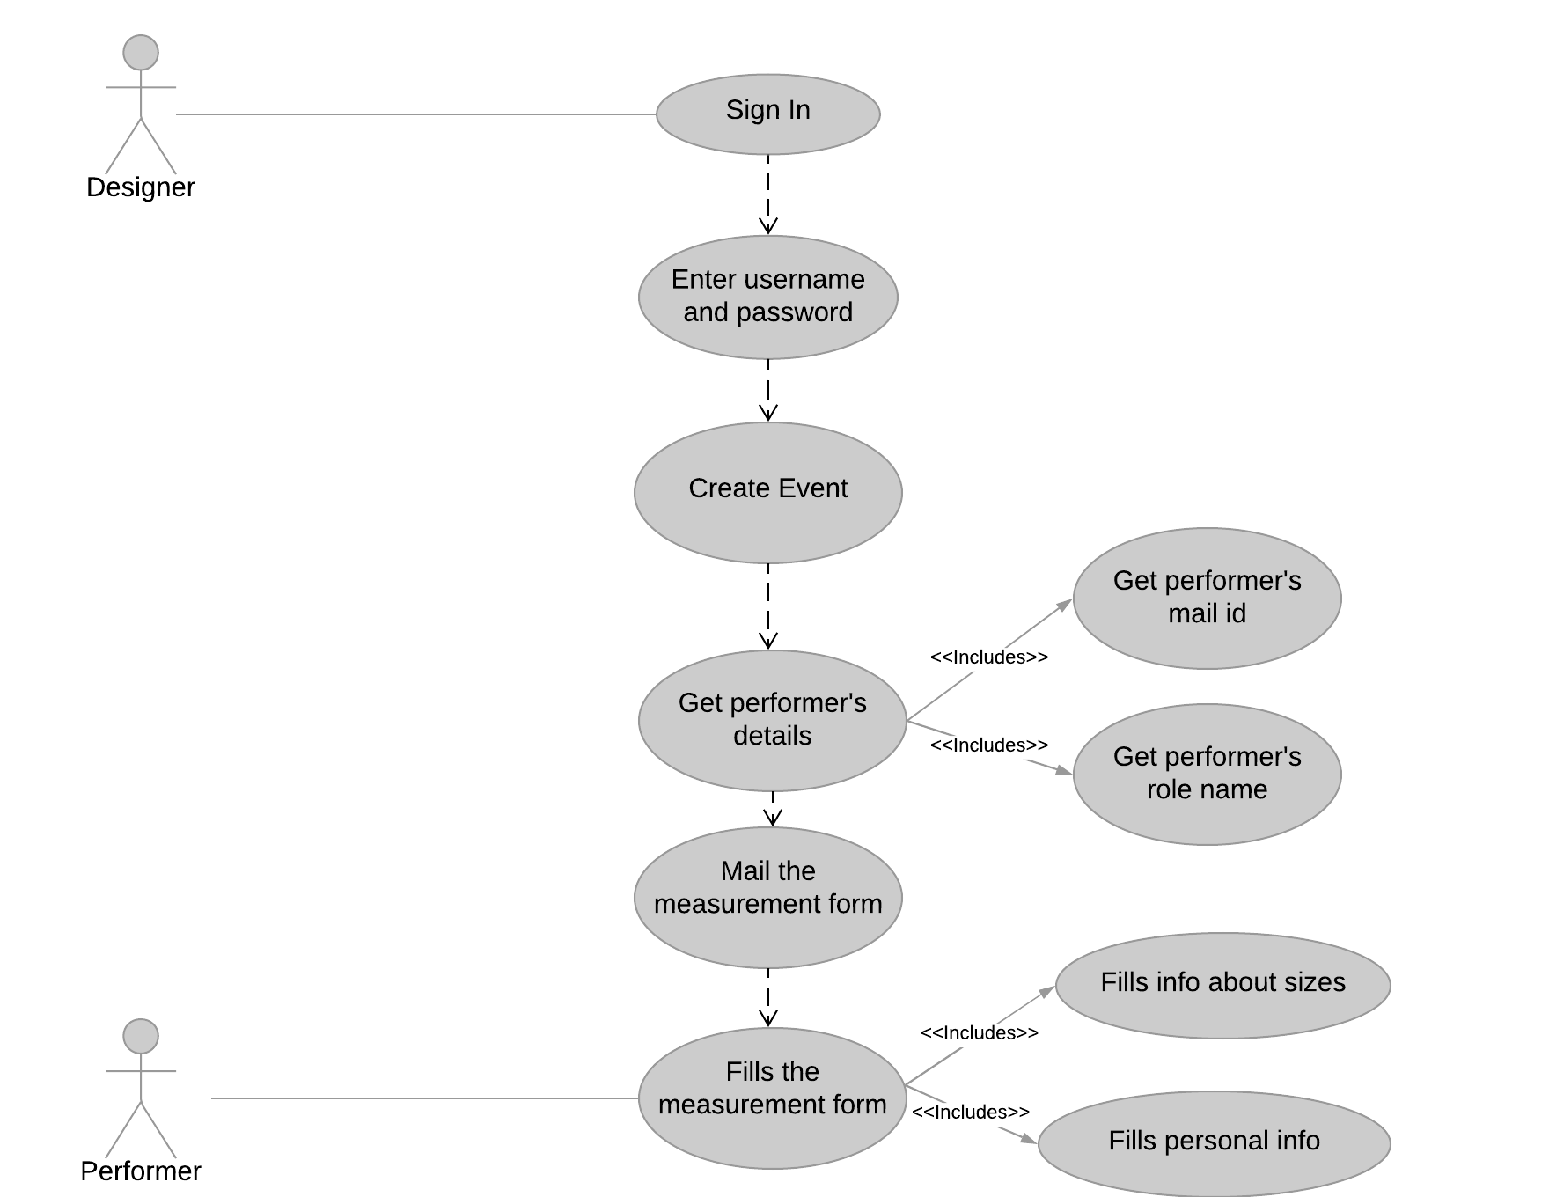
Performer fill form

Slide 15
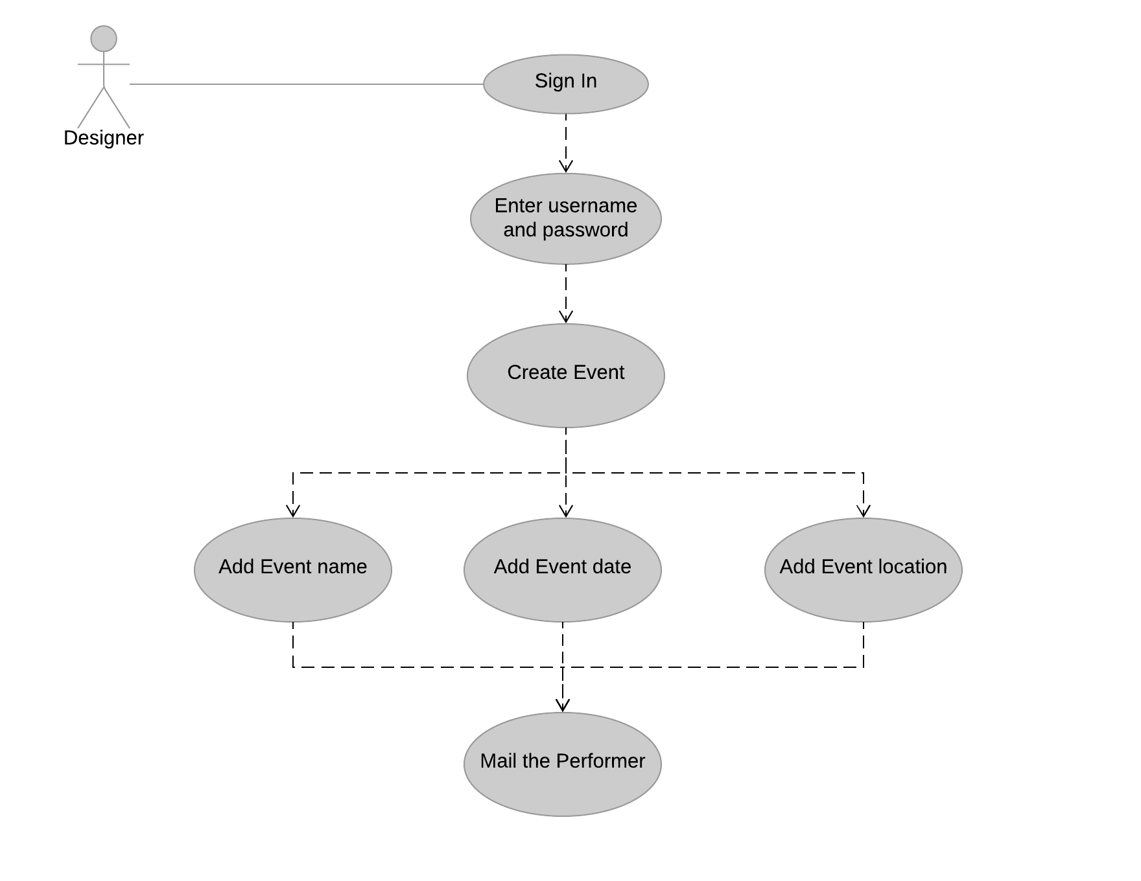
Create Event

Slide 16
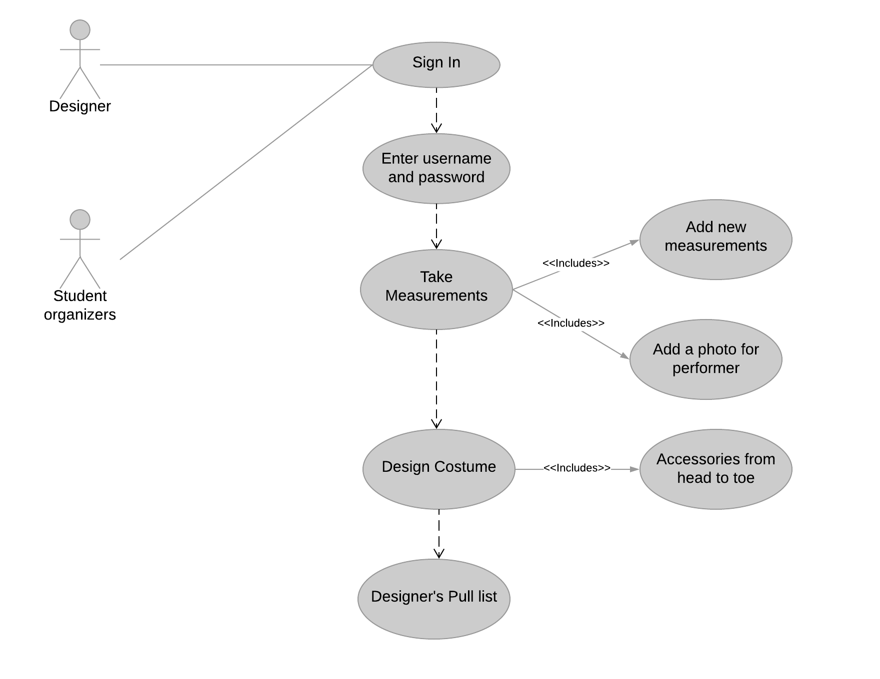
Design Costume

Slide 17
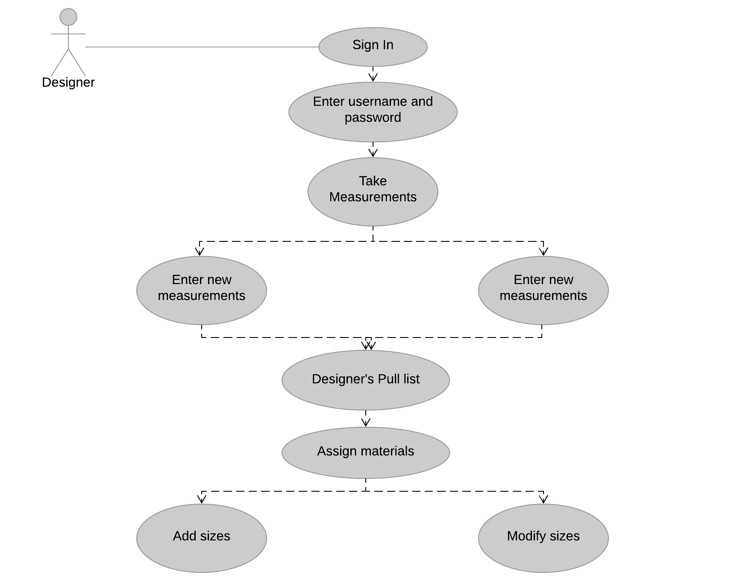
Designer’s Pull list

Slide 18
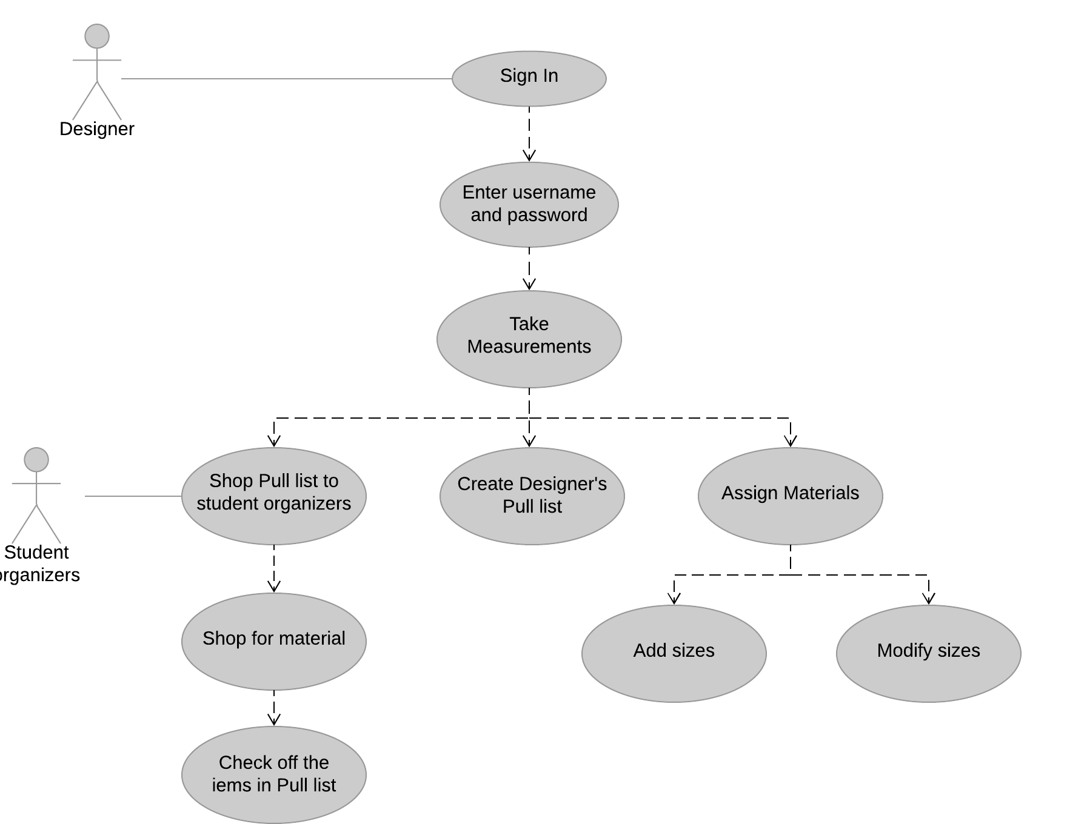
Shop Pull list

Slide 19
Functional requirements
The system SHALL allow only the designer to sign in.
The system SHALL provide access codes to the student organizers.
The system SHALL allow the designer to create an event.
The system SHALL provide a designer pull list.
The system SHALL provide a predefined drop-down list while taking information of the performer.

Slide 20
Functional requirements
The system SHALL allow the designer to upload a photo of performer while taking measurements.
The system SHOULD allow the designer/student organizers to search by show/performer/month.
The system SHOULD display the projects with pictures/text according to the deadlines.
The system SHOULD provide a list for the student organizers to check off the items from the designers pull list.

Slide 21
Functional requirements
The system SHOULD allow the designer to sign out.
The system SHOULD mail the personal info form to the performers.
The system MAY provide instructions to get into the designers office in contact page of designer.
The system MAY provide the information about the costume progress to the student organizers and the designer.

Slide 22

Notes:
Retrieved from

Slide 23
Data Management Plan
DMP, in brief, is to determine how the data will be created, how data will be documented, who can access it and where is it stored.
We need to store the information related to designers and organizers along with the encrypted password and access code for each user.
The main part of the project is to store the data related to performers.
We store the personal information of the performer along with medication and general measurements and the measurements were taken by the designer.

Slide 24
Data Management Plan
By storing the information of designers and organizers we can provide the login and sign up functionality along with the access permissions.
By storing the performer information and measurements information, we can filter the same data in different fields that gives flexibility to the designers.
We store the information related to plays/events that gives makes the dashboard showing event information with deadlines.

Slide 25
Data Management Plan
Personal and Medication Information
Name of the performer
Character name
Age
Mail id
Address
Contact number
Sample pictures
Notes about allergies
Height
Color(hair, eye)
General Measurements
Waist
Sleeve
Hip
Inseam
Out seam
Shoe Size
Head

Slide 26
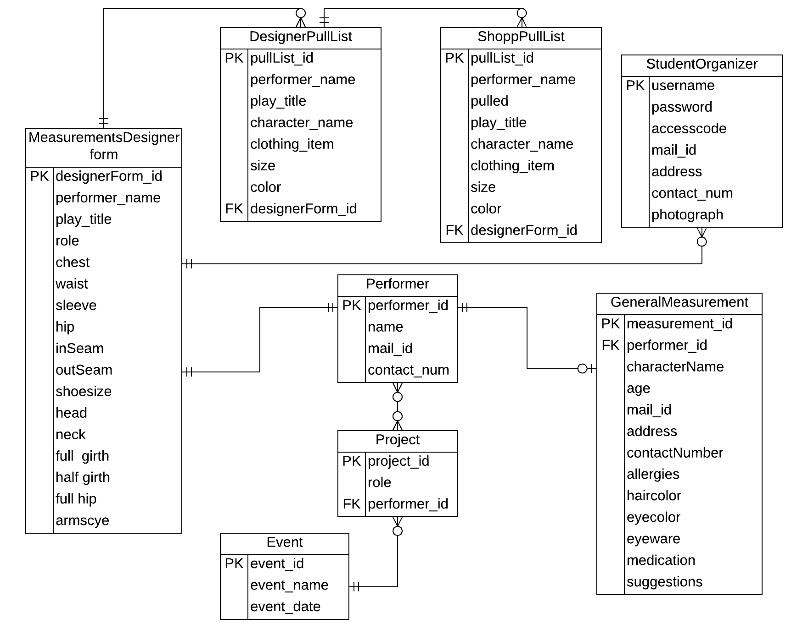
ER Diagram

Slide 27
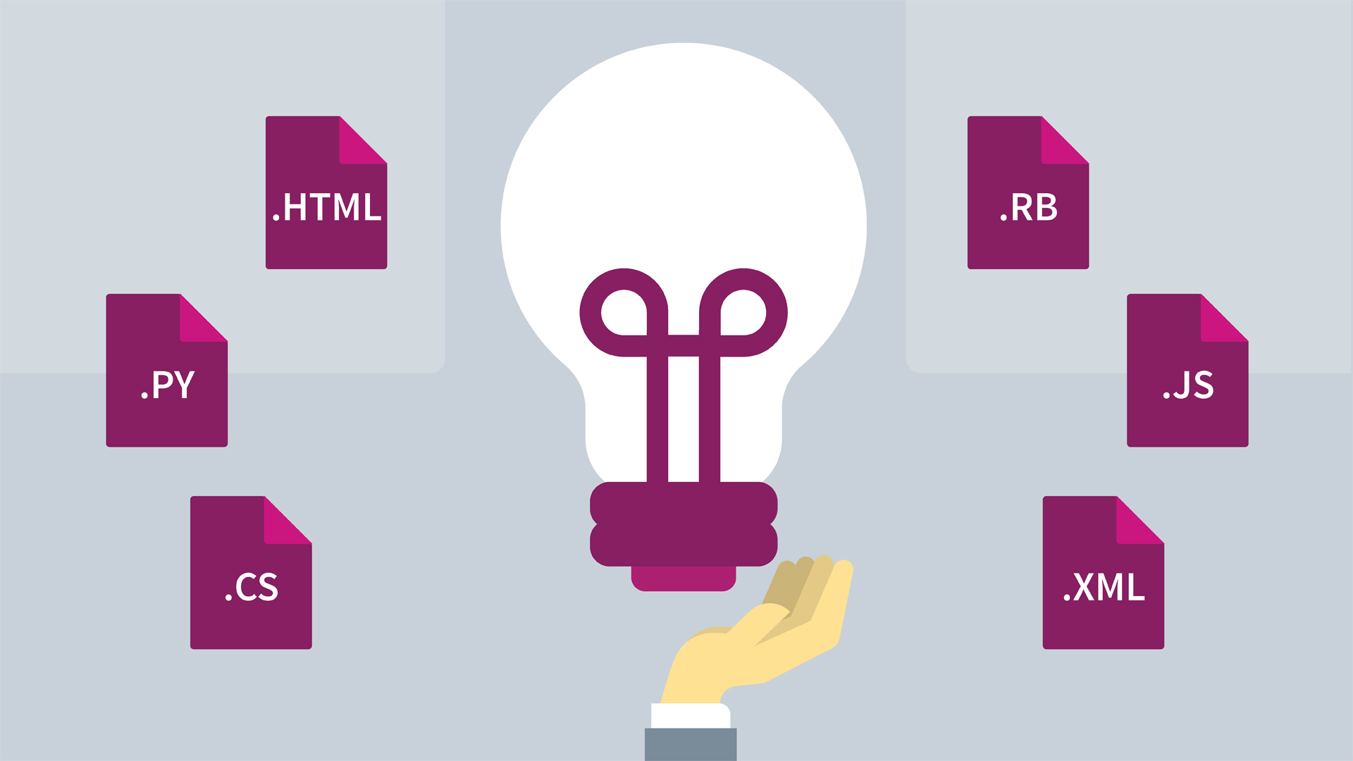
Design Patterns
Notes:
Figure retrieved from https://www.lynda.com/Design-Patterns-training-tutorials/1304-0.html

Slide 28
Design Patterns
We are implementing MVC(Model-View-Controller) pattern.
Model:
The data in the database is used by the designer to create a designer’s pull list which is given to the organizers as a shop pull list.
The performers information can be displayed based on the projects.
The performer’s photo is displayed along with the measurements.

Slide 29
Design Patterns
View:
The information that is to be displayed is the performer’s measurements and a measurement form to the performers.
The designer uses the interactive elements like sending the mail to the performer and entering the measurements with the help of images.

Slide 30
Design Patterns
Controller:
Based on the measurements stored in the database the measurements can be selected from the dropdown list.
The element used for interaction is the measurement form filled by the performer.

Slide 31


Platforms and Technologies
Platform Database
Windows MongoDB
Notes:
Retrieved from
https://www.wired.com/2017/05/still-use-windows-xp-prepare-worst/
https://www.mongodb.com/

Slide 32
Platforms and Technologies
Client side scripting/coding:
HTML
CSS
JavaScript
Server side scripting/coding:
Node.js

Slide 33
Third Part Libraries
Express
Passport
JS PDF
Mongoose

Slide 34

Hosting strategy and Requirements
Heroku
Notes:
Retrieved from
https://obviate.io/2015/08/24/a-pinterest-success-story/
https://www.sitepoint.com/deploying-to-heroku-an-introduction/
https://hide.me/en/features/zero-logging-dns
https://en.wikipedia.org/wiki/Amazon_Web_Services

Slide 35

Notes:
Retrieved figure from https://www.xerox.com/en-us/connectkey/printer-security

Slide 36

Security Plans
Securing user password:
By using hashing algorithm we can make the passwords secure.
We are planning to use MD-5 algorithm for security.
MD-5 is a hashing algorithm which converts any value of data to a constant length value.
Notes:
Retrieved from
https://www.123rf.com/photo_54630342_stock-vector-password-security-security-system-illustration-password-lock-protection-of-user-data-computer-securi.html

Slide 37

Security Plans
Securing performer’s personal information
SQL injection would be a threat to the user’s personal data.
Notes:
Retrieved from
https://www.kisspng.com/png-computer-security-data-security-user-personal-info-1805955/preview.html

Slide 38
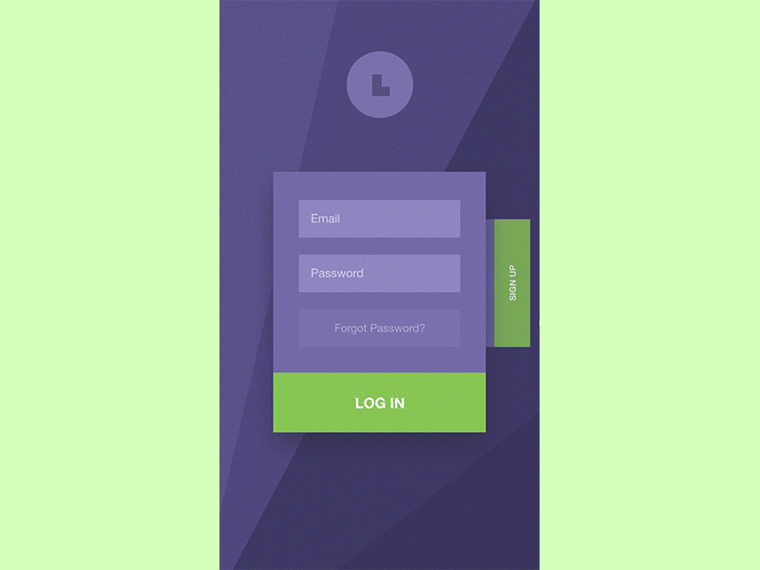
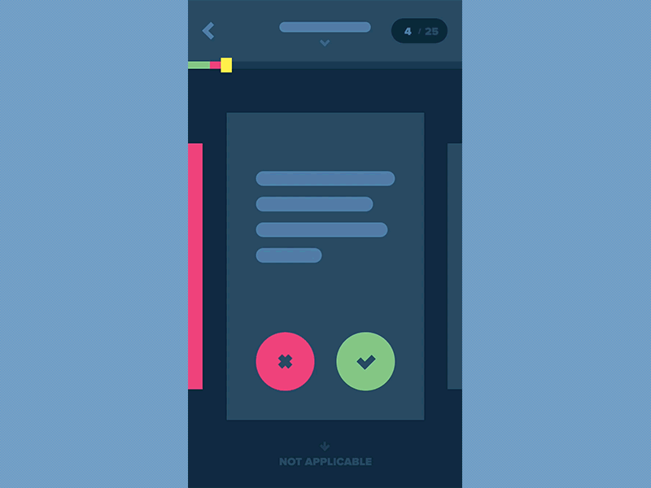
Prototype Demos
Notes:
Figures retrieved from https://stories.uplabs.com/a-practical-guide-to-convert-your-sketches-to-working-prototypes-5b1a732d1eb5

Slide 39
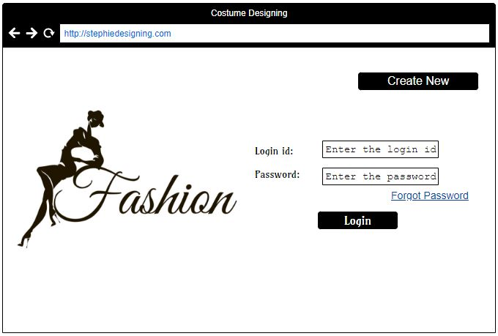
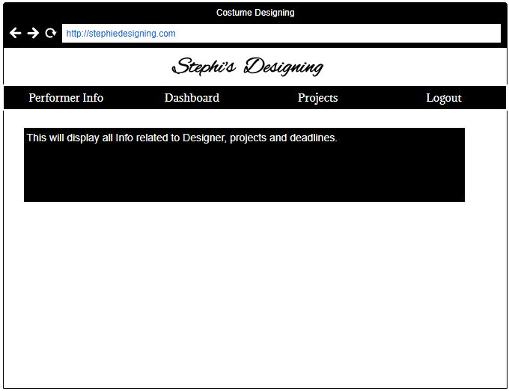
GUI Mockups

Slide 40
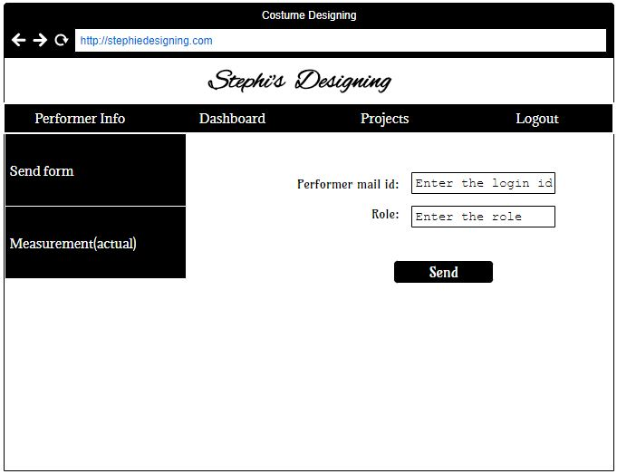
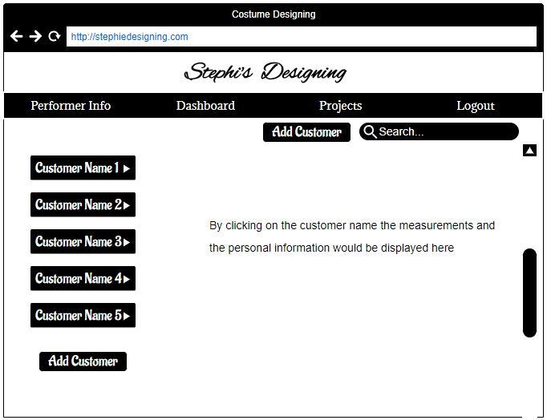
GUI Mockups

Slide 41
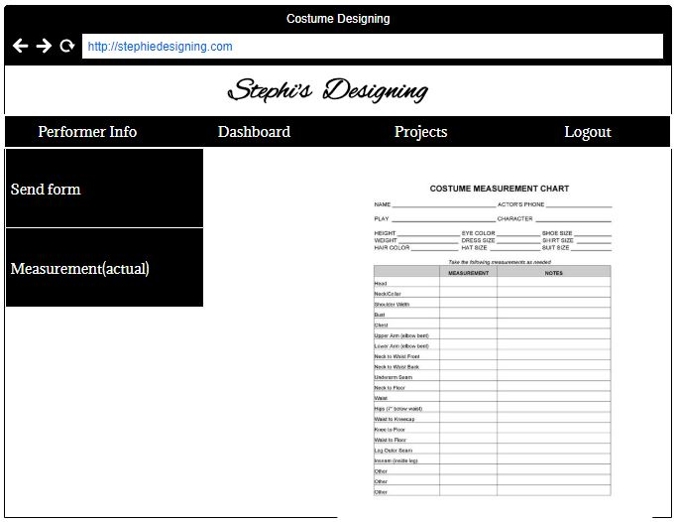
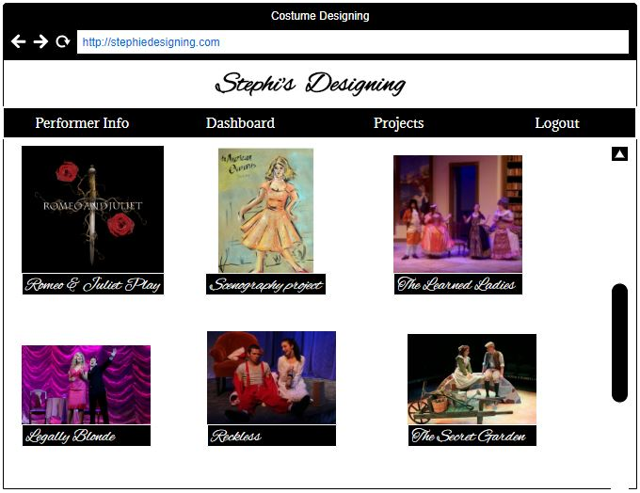
GUI Mockups

Slide 42
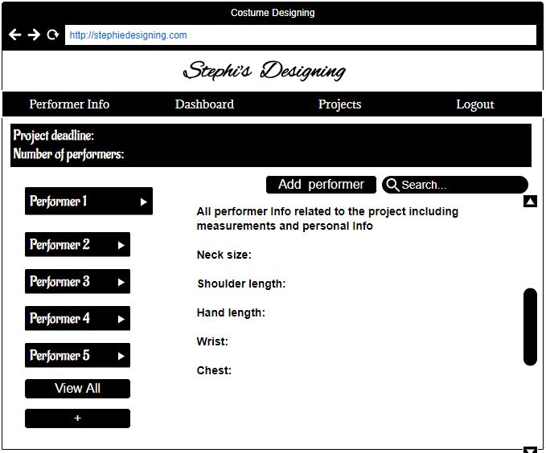
GUI Mockups

Slide 43
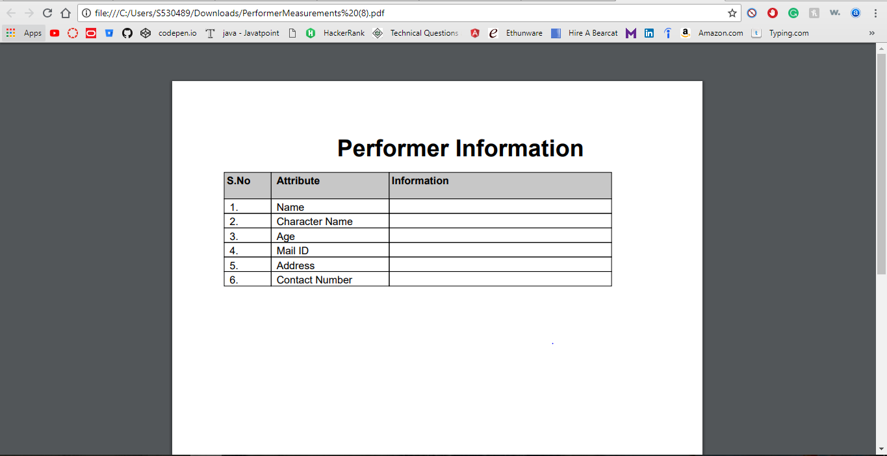
Functional Prototypes
Download the measurements in pdf format.

Slide 44
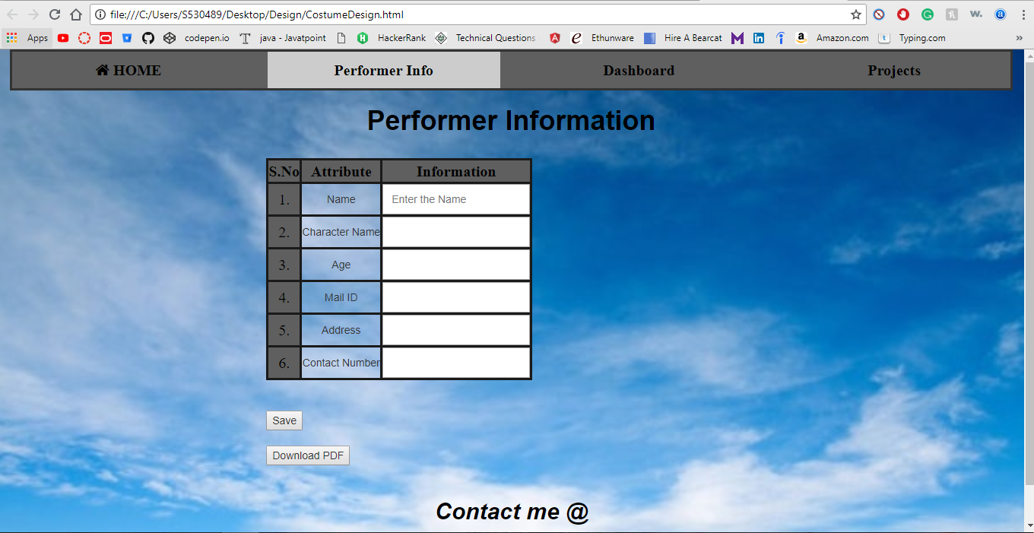
Functional Prototypes
To enter measurements of a performer.

Slide 45
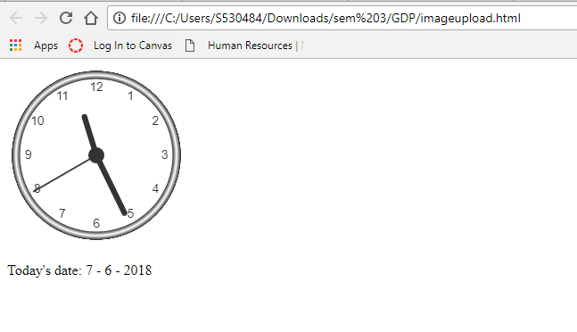
Functional Prototypes
Display a clock in the website

Slide 46
Conclusion
The main motivation for solving the problem is to reduce the time and effort by making possible to the designer to select the pull list directly without using the paperwork.
Also to maintain the coordination with all the team members using the central database with proper access permission.

Slide 47
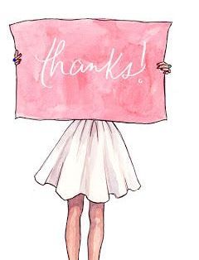
Thank You & Queries?

